Slide 1
Western Resource Adequacy Program
June 24, 2024
Michael O’Brien
Senior Engagement Manager, Western Resource Adequacy Program
Western Power Pool
Nevada – Regional Transmission Coordination Task Force

Slide 2
Setting the Stage
01
Western Power Pool
02
Western Resource Adequacy Program
03
Western Transmission Expansion Coalition

Slide 3
WPP Provides a Range of Valuable Grid Integration and Coordination Services to its Customer-Members throughout the entire Western Interconnection
Transmission Services
Training
Resource Adequacy*
Frequency Response Sharing Group
Hydro Modeling
Reserve Sharing Group
*Under WPP independent governance (others governed by participants or agreements)

Slide 4
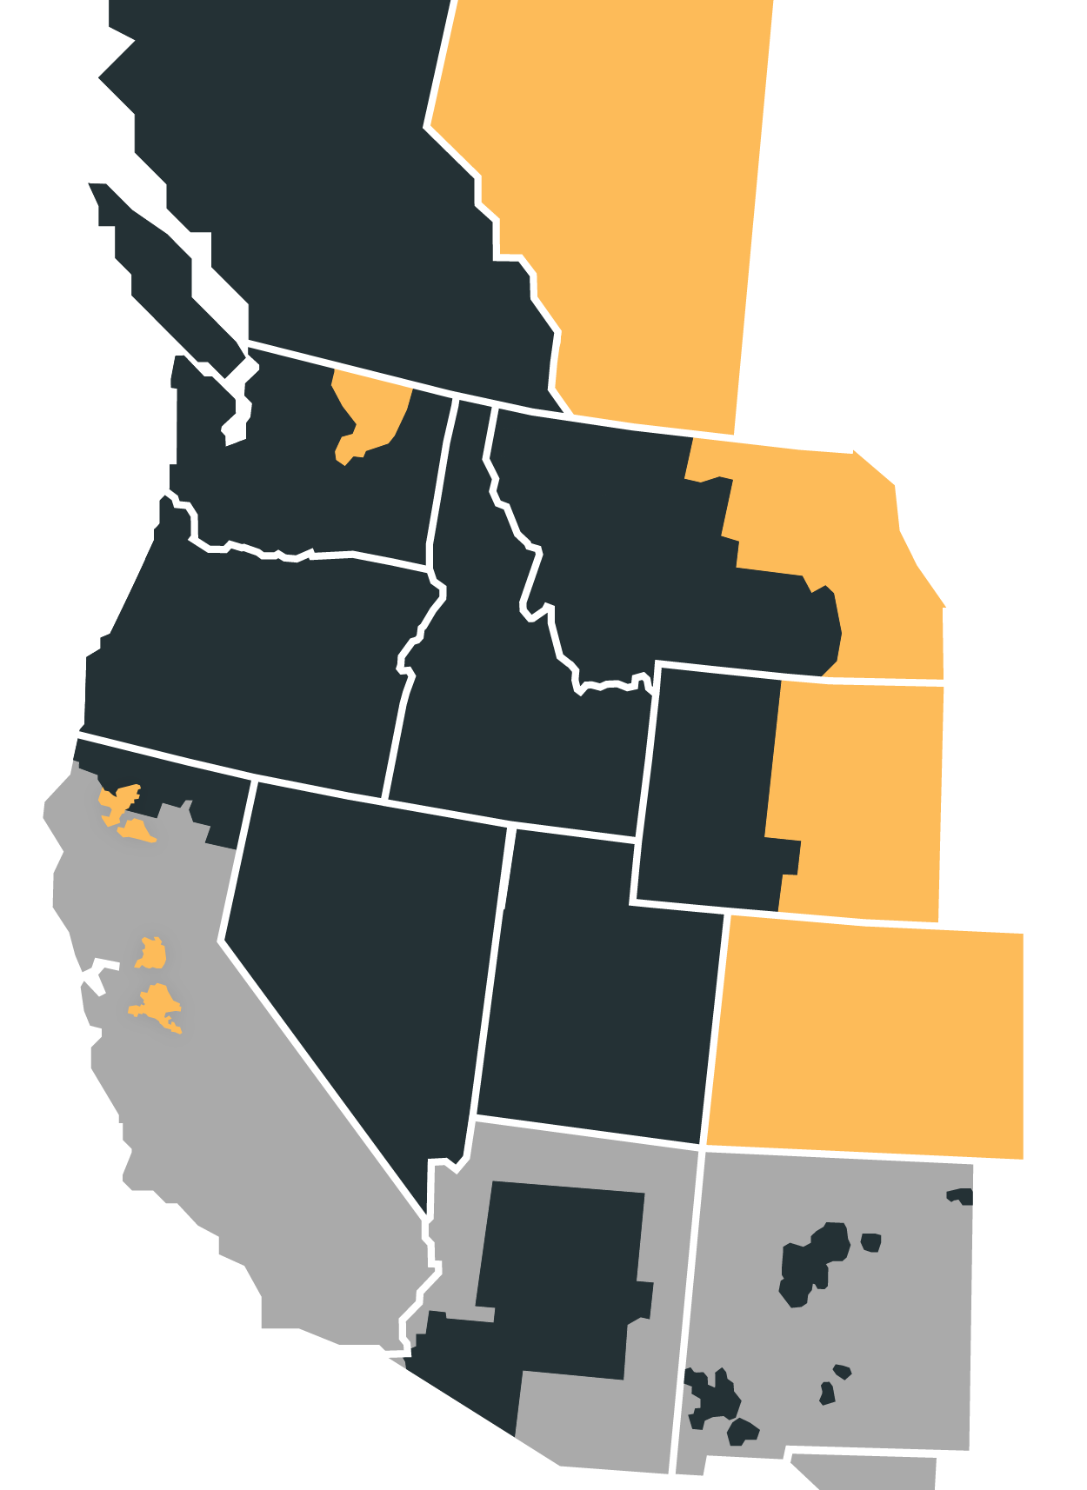
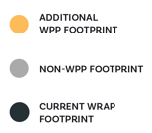
Current
WRAP Participants
Arizona Public Service
Avista
Bonneville Power Administration
Calpine
Chelan County PUD
Clatskanie PUD
Eugene Water & Electric Board
Grant PUD
Idaho Power
Northwestern Energy
NV Energy
PacifiCorp
Portland General Electric
Powerex
Public Service Company of New Mexico
Puget Sound Energy
Salt River Project
Seattle City Light
Shell Energy
Snohomish PUD
Tacoma Power
The Energy Authority
Notes:
Rebecca

Slide 5
Roles of the PA and PO
Western Power Pool (WPP) serves as the Program Administrator (PA) of the WRAP
  Undertakes all actions necessary to implement and administer program
Southwest Power Pool (SPP) serves as the Program Operator (PO) of the WRAP
  Provides technical, analytical, and implementation support to the Program Administrator

Slide 6
WRAP VALUE PROPOSITION
  Binding forward showing requires Participants to show they have secured their share of the regional capacity need for the upcoming season using common planning and capacity accreditation metrics
  Binding operational program obligates Participants with surplus to assist Participants with a deficit in the hours of highest need using bilateral trading mechanisms
Set of common analytically derived reliability metrics
Leveraging load and resource diversity for reliability

Slide 7
Program Design Overview
Forward Showing
Determine Program Capacity Requirement
Determine Resource Capacity Contribution
Compliance Review of Portfolio
  Establishes a regional reliability metric (seasonal 1 event-day in 10 years LOLE)
    Transition away from utility-by-utility RA programs and assumptions
  Registered resources receive a Qualifying Capacity Contribution (QCC) in advance of forward showing deadlines (seven months ahead of winter and summer seasons)
    Resource-agnostic, consistent methodology for assessing capacity contribution
  Non-compliance with forward showing requirements (capacity or transmission) results in a Forward Showing Deficiency Charge

Slide 8
Program Design Overview
Operations Program
FS Expectations
Operational Reality
Sharing Requirement
  Evaluates participants operational situation relative to Forward Showing assumptions
  Obligates participants with calculated surplus to assist participants with a calculated deficit on the hours of highest need
  Surplus Participant that fails to provide assigned Energy Deployment must pay Energy Delivery Failure Charge

Slide 9

Program Design Overview
Operations Program – Time Horizons
FORWARD SHOWING
OPERATIONAL
AFTER THE FACT
2 and 5 Years Prior
7 Months Prior
3-5 Months Prior
7 Days Prior
Real-Time
Multi-Year LOLE Assessment
Portfolio
Deadline
Cure Period
Rolling Daily
Assessment
Sharing
Event
Settlements

Slide 10
2023-2024 Implementation
BPM Drafting Process
Opportunities for public comment
August 23 2023
Board adoption of BPMs 105, 201, 206
December 6 2023
Board adoption of BPMs 101, 109, 210, 301, 302, 303
March 7 2024
Board adoption of BPMs 104, 107, 108, 304
June 13 2024
Board adoption of 5 BPMs
September 19 2024
Board adoption
of 6 BPMs & Tariff NTFs
Begin Official Tariff/BPM Revision Process
February 2023
Seated Independent Board
2023 Q1
2023 Q2
2023 Q3
2023 Q4
2024 Q1
2024 Q2
2024 Q3
2024 Q4
Winter 2023-2024
(NB Ops)
Summer 2024
(NB Ops)
Winter 2024-2025
(NB Ops)
March 31 2024
Non-Binding FS – Winter 2024-2025
June 1 2024
Non-Binding Ops – Summer 2024
October 31 2024
Non-Binding FS – Summer 2025
November 1 2024
Non-Binding Ops – Winter 2024-25
Winter Season: November – March 15
Summer Season: June – September 15

Slide 11
Implementation Ahead
Transition Seasons (Ops and FS)
Summer 25 through Winter 27-28
Summer
(NB)
Summer
(transition)
Summer
(transition)
Summer
(binding)
2025
2026
2027
2028
Winter
(transition)
Winter
(transition)
Winter
(transition)
Targeting Binding Program With Revised Transition Provisions
Modified Excused Transition Deficits and Cone Charge Deductions
Binding Program Without Transition Provisions
Summer 28 and all seasons following

Slide 12


Slide 13
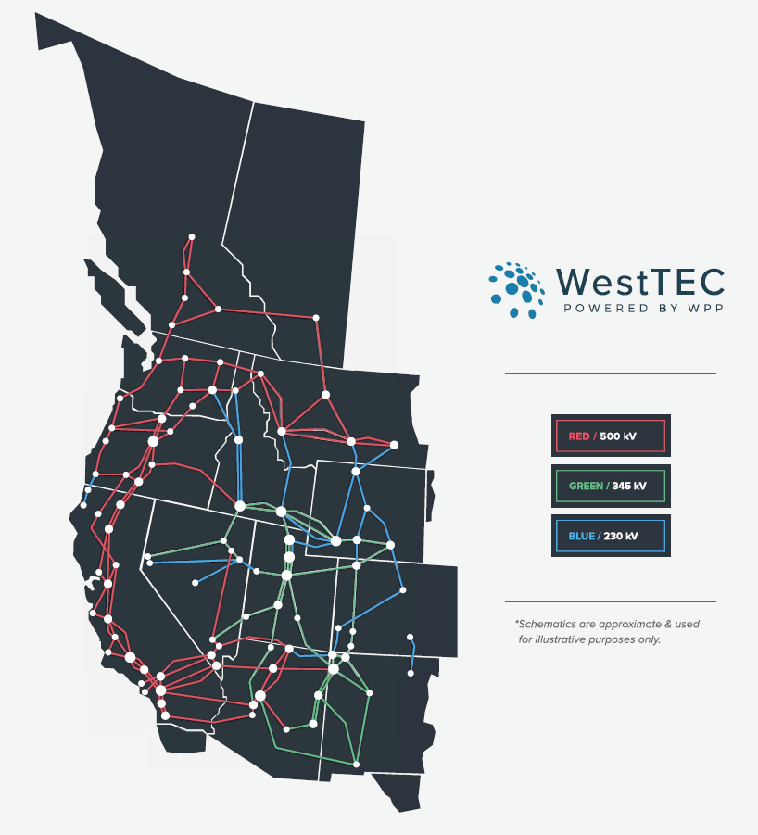
What is the Western Transmission Expansion Coalition?
“WestTEC”
Not a FERC process
West-wide 20-year transmission study (10-year look)
Industry-led with unprecedented stakeholder inclusion
Goal is to produce an actionable transmission study

Slide 14
Questions?
Michael O’Brien- Senior Engagement Manager
Michael.OBrien@WesternPowerPool.org

